Slide 1
Hello! Let’s talk…

Slide 2
Recap (Session 2)
Let’s make a simple HTML design:
<html>
<body>
This is my first website
<!-- This is a comment line! -->
<!-- This is also a comment line! -->
</body>
<html>

Slide 3
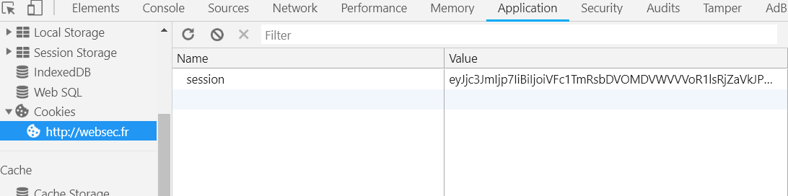
Web Cookie
Cookies are CHANGEABLE in some cases.
Which means some if an application does not sanitize a cookie input or have the correct cookie settings, it may result in unwanted behaviours in the web application.
What if I changed user role from USER to ADMIN?
Web Cookie Example

Slide 4
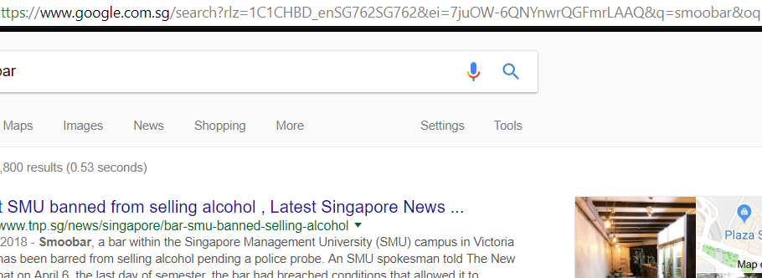
GET REQUEST
../search?rlz=1C1..
GET Request
Data field is IN the URL.

Slide 5
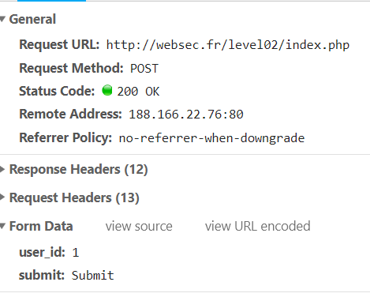
POST REQUEST
POST Request
Data field is IN the POST REQUEST BODY.

Slide 6
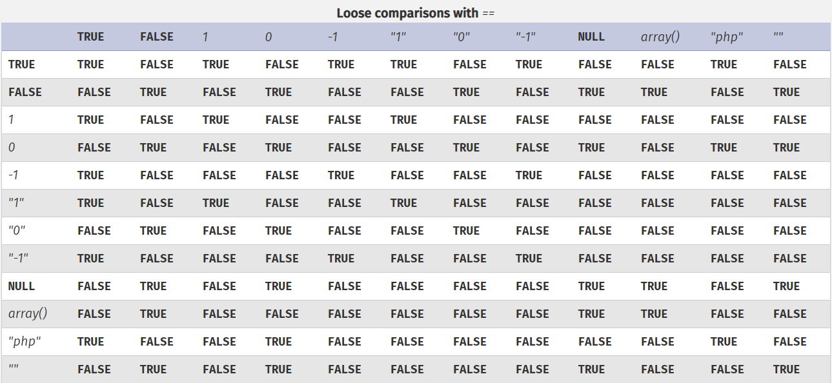
PHP

Slide 7
In Summary of Session 2 (again)
Whenever your page loads:
It is a MADE REQUEST (it includes dynamic parts)
Web cookies may be controlled by the user
PHP have its anomalies ☺

Slide 8
Linux Commands
Session 3

Slide 9
Let’s warm up
Given the commands:
ls
pwd
ls -la
Lets have it in English:
LIST my current directory
Please print my CURRENT working directory
Please LIST my current directory, but I want it in a LIST format with ALL ITEMS printed out.

Slide 10
Command Line Interface
It is a text base user interface.
Typically the choice of tool by system administrators.
Well, for hackers too! ☺

Slide 11
Command Line Interface
Benefits:
Low resource consumption (it is just text)
Quick input/output processing (Load dependent, no rendering needed)
Pretty much a kick-a** tool

Slide 12
Command Line Interface
Drawbacks:
Steep learning curve for beginners ☹
No graphical user interface benefits (drag drop/native copy paste)
Requires external modification to make it “Super fancy”

Slide 13
Command Line Interface
But why do we use it for CTF?:
Pretty much all the tools in ethical hacking/CTF is command line
Fastest way to interact with any computing resources
Huge help resource online pertaining to CLI use cases

Slide 14
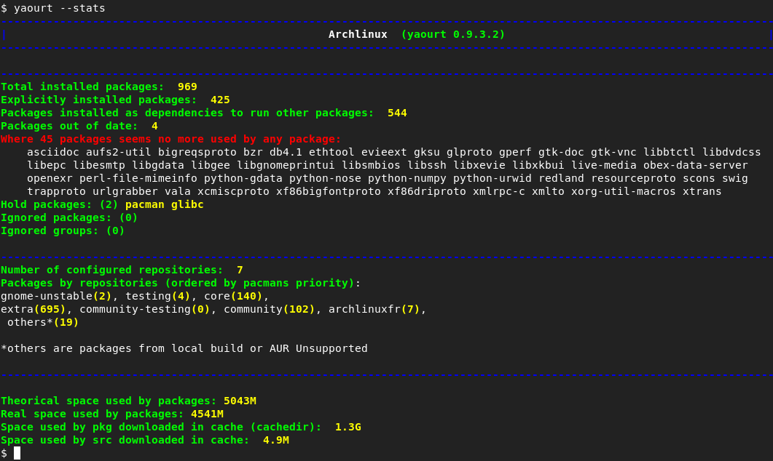
Command Line Interface

Slide 15
I ‘Shell’ Command You
Nickname a “shell”, it is the descriptive word to describe CLI interface
We will get to this later… ☺

Slide 16
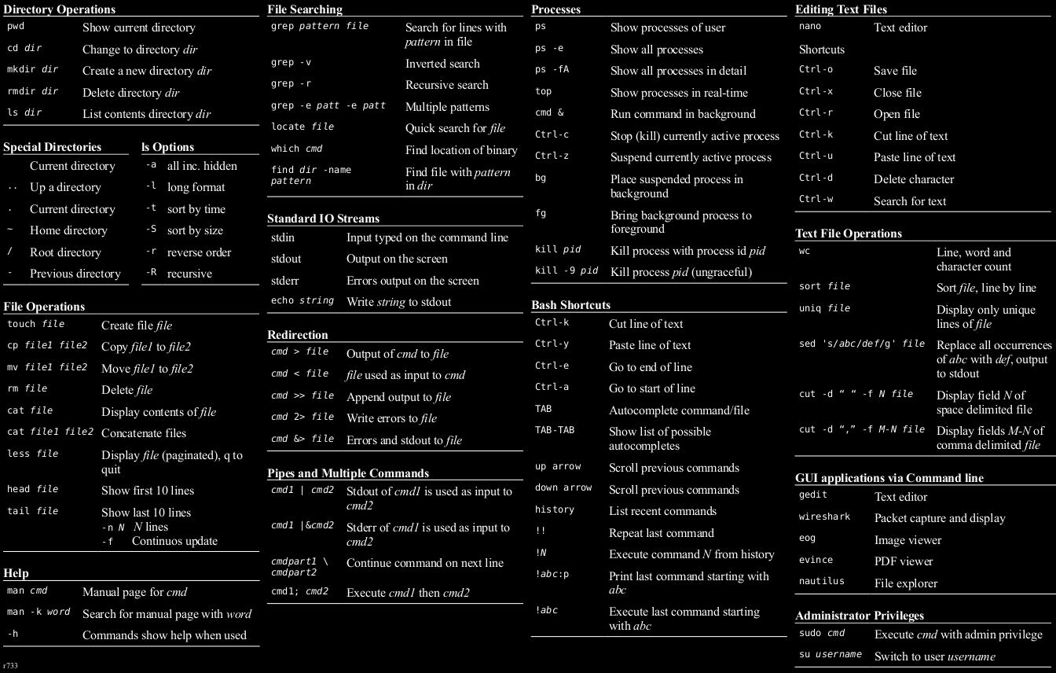
I ‘Shell’ Command You

Slide 17
I ‘Shell’ Command You

Slide 18
I ‘Shell’ Command You

Slide 19
I ‘Shell’ Command You

Slide 20
I ‘Shell’ Command You

Slide 21
I ‘Shell’ Command You

Slide 22
I ‘Shell’ Command You

Slide 23
I ‘Shell’ Command You

Slide 24
I ‘Shell’ Command You

Slide 25
I ‘Shell’ Command You

Slide 26
I ‘Shell’ Command You

Slide 27
I ‘Shell’ Command You

Slide 28
I ‘Shell’ Command You

Slide 29
I ‘Shell’ Command You

Slide 30
I ‘Shell’ Command You

Slide 31
I ‘Shell’ Command You

Slide 32
I ‘Shell’ Command You

Slide 33
I ‘Shell’ Command You

Slide 34
I ‘Shell’ Command You

Slide 35
I ‘Shell’ Command You

Slide 36
I ‘Shell’ Command You

Slide 37
I ‘Shell’ Command You

Slide 38
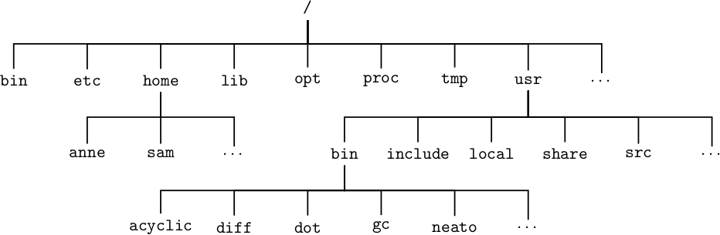
I ‘Shell” be happy
Linux File System Structure

Slide 39
I ‘Shell” be happy
I am here now:
What is my FULL PATH?
Linux File System Structure

Slide 40
I ‘Shell” be happy
I am here now:
/home
Linux File System Structure

Slide 41
I ‘Shell” be happy
I am here now:
/home
But what if I want to land myself in directory ‘anne’ inside home?
Linux File System Structure

Slide 42
I ‘Shell” be happy
I am here now:
/home
But what if I want to land myself in directory ‘anne’ inside home?
Linux File System Structure
The following commands will achieve the outcome:
cd anne
cd /home/anne

Slide 43
I ‘Shell” be happy
Linux File System Structure
Relative Path VS Absolute Path
anne VS /home/anne

Slide 44
I ‘Shell” be happy
Linux File System Structure
Relative Path VS Absolute Path
anne VS /home/anne

Slide 45
I ‘Shell” be happy
recap
In the text terminal, everything is logically structured!

Slide 46
I ‘Shell” be happy
recap
In the text terminal, everything is logically structured!
/home/anne
/var/www/html/

Slide 47
I ‘Shell” be happy
/home/anne
/var/www/html/
recap
In the text terminal, everything is logically structured!

Slide 48
I ‘Shell” be happy
/home/anne
/var/www/html/
recap
In the text terminal, everything is logically structured!
cd anne
cd /home/anne

Slide 49
I ‘Shell” be happy
/home/anne
/var/www/html/
recap
In the text terminal, everything is logically structured!
cat flag.txt
cd anne
cd /home/anne

Slide 50
I ‘Shell” be happy
The two famous symbols:
$
usually means LOW PRIVILEGE USER
#
→ 99.9999999%, you are SUPER USER. (You are god mode in the system)

Slide 51
Hands On
Some fun?

Slide 52
Let’s warm up
Go to this website:
https://www.learnshell.org/

Slide 53
Summary
Most servers operate in Command Line Interface
Command line tools are cool! But not with Web!
The limit to web features is the developer’s creative mind, but the limit to loopholes is the developer’s careless mind!
Google is your best friend for commands! ☺

Slide 54
This week’s theme
Command Injection

